Slide 1
Implementing a REST API
Getting started
Defining a simple REST API
Defining a full REST API
Demo Spring module: demo-rest-services

Slide 2
1. Getting Started
Creating a Spring Boot web application
The role of REST services
REST services in Spring MVC
Supporting JSON and XML
Defining a model class
Demo package: demo.restservices

Slide 3
Creating a Spring Boot Web Application
To create a Spring Boot web application, either add the Spring Web dependency…
Or add the Spring Reactive Web dependency…
New in Spring Boot 2, good if you have very high load
We'll do this
<dependency>
<groupId>org.springframework.boot</groupId>
<artifactId>spring-boot-starter-web</artifactId>
</dependency>
pom.xml
<dependency>
<groupId>org.springframework.boot</groupId>
<artifactId>spring-boot-starter-webflux</artifactId>
</dependency>
pom.xml
3

Slide 4
The Role of REST Services
A REST service is an endpoint in a web application
Has methods that are mapped to URLs
Easily accessible by clients over HTTP(S)
Consume/return data, typically JSON (or XML)
The role of REST services in a full-stack application:
Callable from UI, e.g. from a React web UI
Provides a façade to back-end data/functionality
4

Slide 5
REST Services in Spring MVC
This is how REST services work in Spring MVC:
DispatcherServlet bean listens for HTTP requests
It dispatches a request to a method on a controller bean
The method returns data to the client
HTTP request
aMethod
HTTP response
DispatcherServlet
bean created by Spring Boot
Controller bean
implemented by you
Other beans
e.g. repositories
5

Slide 6
Supporting JSON and XML
REST controller methods receive/return Java objects
Spring Boot automatically creates a JSON serializer bean, to convert Java objects to/from JSON
If you also want to support XML serialization, you must add the following dependency:
<dependency>
<groupId>com.fasterxml.jackson.dataformat</groupId>
<artifactId>jackson-dataformat-xml</artifactId>
</dependency>
pom.xml
6

Slide 7
Defining a Model Class
We'll use the following POJO class in our REST services
The JSON/XML serializers will automatically convert Product objects to/from JSON/XML as appropriate
public class Product {
private long id;
private String description;
private double price;
// Plus constructors, getters/setters, etc …
}
Product.java
7

Slide 8
2. Defining a Simple REST API
How to define a REST controller
Example REST controller
Pinging the simple REST controller
A better approach
Mapping path variables
Mapping request parameters

Slide 9
How to Define a REST Controller
Define a class and annotate with:
@Controller (or @RestController)
@RequestMapping (optional base URL)
@CrossOrigin (optional CORS support)
Define methods annotated with one of the following:
@GetMapping, @PostMapping, @PutMapping, @DeleteMapping,@RequestMapping
For each method, also specify path and data-types
9

Slide 10
Example REST Controller
Here's a simple REST controller
The method returns a collection of products
@RestController
@RequestMapping("/simple")
@CrossOrigin
public class SimpleController {
private Map<Long, Product> catalog = new HashMap<>();
…
@GetMapping(value="/productsV1", produces={"application/json","application/xml"})
public Collection<Product> getProductsV1() {
return catalog.values();
}
…
}
SimpleController.java
10

Slide 11
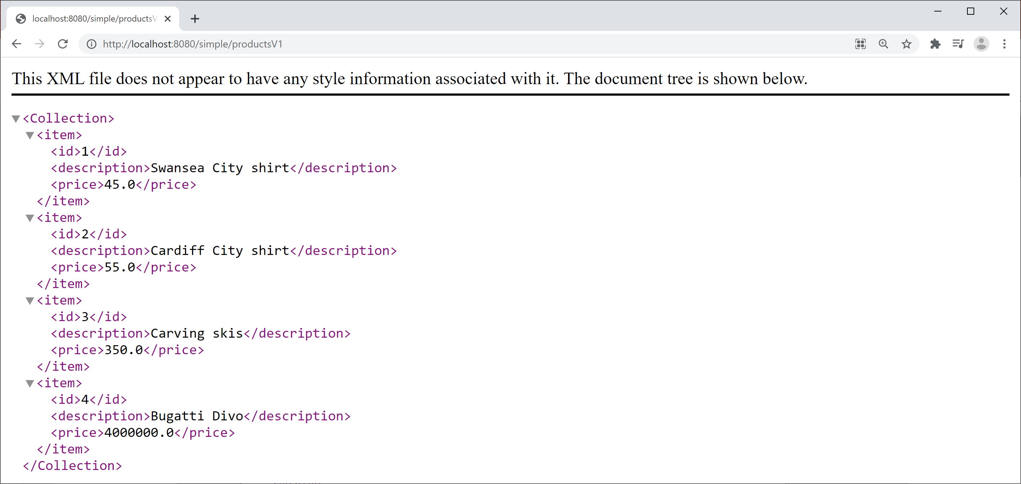
Pinging the Simple REST Controller
Run the Spring Boot app, then browse to:
http://localhost:8080/simple/productsV1
11

Slide 12
A Better Approach
So far, we return a Collection<Product>
This populates the HTTP response body
It doesn't set the HTTP status code or any other headers
A better approach is to return ResponseEntity<T>
Gives full control over the entire HTTP response body
Enables us to set HTTP status code and other headers
@GetMapping(value="/productsV2", produces={"application/json","application/xml"})
public ResponseEntity<Collection<Product>> getProductsV2() {
return ResponseEntity.ok().body(catalog.values());
}
SimpleController.java
12

Slide 13
Mapping Path Variables
You can map parts of the path to variables
In the path, define {…} placeholder(s)
In the method, annotate param with @PathVariable
http://localhost:8080/simple/products/1
@GetMapping(value="/products/{id}", produces={"application/json","application/xml"})
public ResponseEntity<Product> getProductById(@PathVariable long id) {
Product p = catalog.get(id);
if (p == null)
return ResponseEntity.notFound().build();
else
return ResponseEntity.ok().body(p);
}
SimpleController.java
13

Slide 14
Mapping Request Parameters
You can map HTTP request parameter(s)
In the path, optionally provide parameter(s) after ?
In the method, annotate param with @RequestParam
http://localhost:8080/simple/products?min=100
@GetMapping(value="/products", produces={"application/json","application/xml"})
public ResponseEntity<Collection<Product>> getProductsMoreThan(
@RequestParam(value="min", required=false, defaultValue="0.0") double min) {
Collection<Product> products = catalog.values()
.stream()
.filter(p -> p.getPrice() > min)
.collect(Collectors.toList());
return ResponseEntity.ok().body(products);
}
SimpleController.java
14

Slide 15
3. Defining a Full REST API
Overview
Example REST controller
Testing the example REST controller
Implementing a POST method
Implementing a PUT method
Implementing a DELETE method

Slide 16
Overview
So far, we've seen how to GET data from a REST service
Here's how to support the other HTTP verbs
@GetMapping(value= … )
@PostMapping(value= … )
@PutMapping(value= … )
@DeleteMapping(value= … )
16

Slide 17
Example REST Controller
Here's the example REST controller for this section:
Note:
We've now implemented a repository to manage data
@RestController
@RequestMapping("/full")
@CrossOrigin
public class FullController {
@Autowired
private ProductRepository repository;
// Full CRUD API, see following slides
…
}
FullController.java
17

Slide 18
Testing the Example REST Controller
We'll test the service using ARC (a free Google plugin)
Install from https://install.advancedrestclient.com
Allows you to submit all kinds of requests to a URL
GET, PUT, POST, DELETE, etc.
Also allows you to set HTTP headers on your request
E.g. Content-Type=application/json
E.g. Accept=application/json
18

Slide 19
Implementing a POST Method
A POST method typically inserts a resource
Client passes new object in HTTP request body
Service returns enriched object after insertion
Service returns status code 201, plus LOCATION header
@PostMapping(
value="/products",
consumes={"application/json","application/xml"},
produces={"application/json","application/xml"})
public ResponseEntity<Product> insertProduct(@RequestBody Product product) {
repository.insert(product);
URI uri = URI.create("/full/products/" + product.getId());
return ResponseEntity.created(uri).body(product);
}
FullController.java
19

Slide 20
Implementing a PUT Method
A PUT method typically updates an existing resource
Client passes id in URL, and object in HTTP request body
Service returns status code 200 or 404
@PutMapping(value="/products/{id}", consumes={"application/json","application/xml"})
public ResponseEntity<Void> updateProduct(@PathVariable long id,
@RequestBody Product product) {
if (!repository.update(product))
return ResponseEntity.notFound().build();
else
return ResponseEntity.ok().build();
}
FullController.java
20

Slide 21
Implementing a DELETE Method
A DELETE method typically deletes an existing resource
Client passes id in URL
Service returns status code 200 or 404
@DeleteMapping("/products/{id}")
public ResponseEntity<Void> deleteProduct(@PathVariable long id) {
if (!repository.delete(id))
return ResponseEntity.notFound().build();
else
return ResponseEntity.ok().build();
}
FullController.java
21

Slide 22
Summary
Getting started
Defining a simple REST API
Defining a full REST API

